Slide 1





CloudBoosta Academy · Group B · Option 1
S3 + Bedrock
Sloff Electronics
RAG Chatbot on AWS Bedrock
Embeddings
Retrieval-Augmented Generation using Amazon Bedrock Knowledge Base,
Titan Embeddings G1, OpenSearch Serverless, and Claude Sonnet 4.6
Vector Search
Group B Members
Claude 4.6
· Osahon Igbogbo
· Chinedu Izuelu
· Emmanuel Onuoha
· Israel Olayinka
· Bolarinwa Akinde
May 2026 · us-east-1

Slide 2

THE PROBLEM
Why a RAG chatbot?
Business Challenge
RAG Solution
Static PDFs hold all company knowledge, no intelligent query layer
Accepts natural language questions in plain English
Traditional search returns documents, not answers
Retrieves relevant passages from Sloff Electronics' own documents
Support agents manually search documents for every customer query
Generates precise, cited answers grounded in source data only
Standard LLMs hallucinate, they can't access proprietary data
Cannot hallucinate, constrained to retrieved document chunks

Slide 3
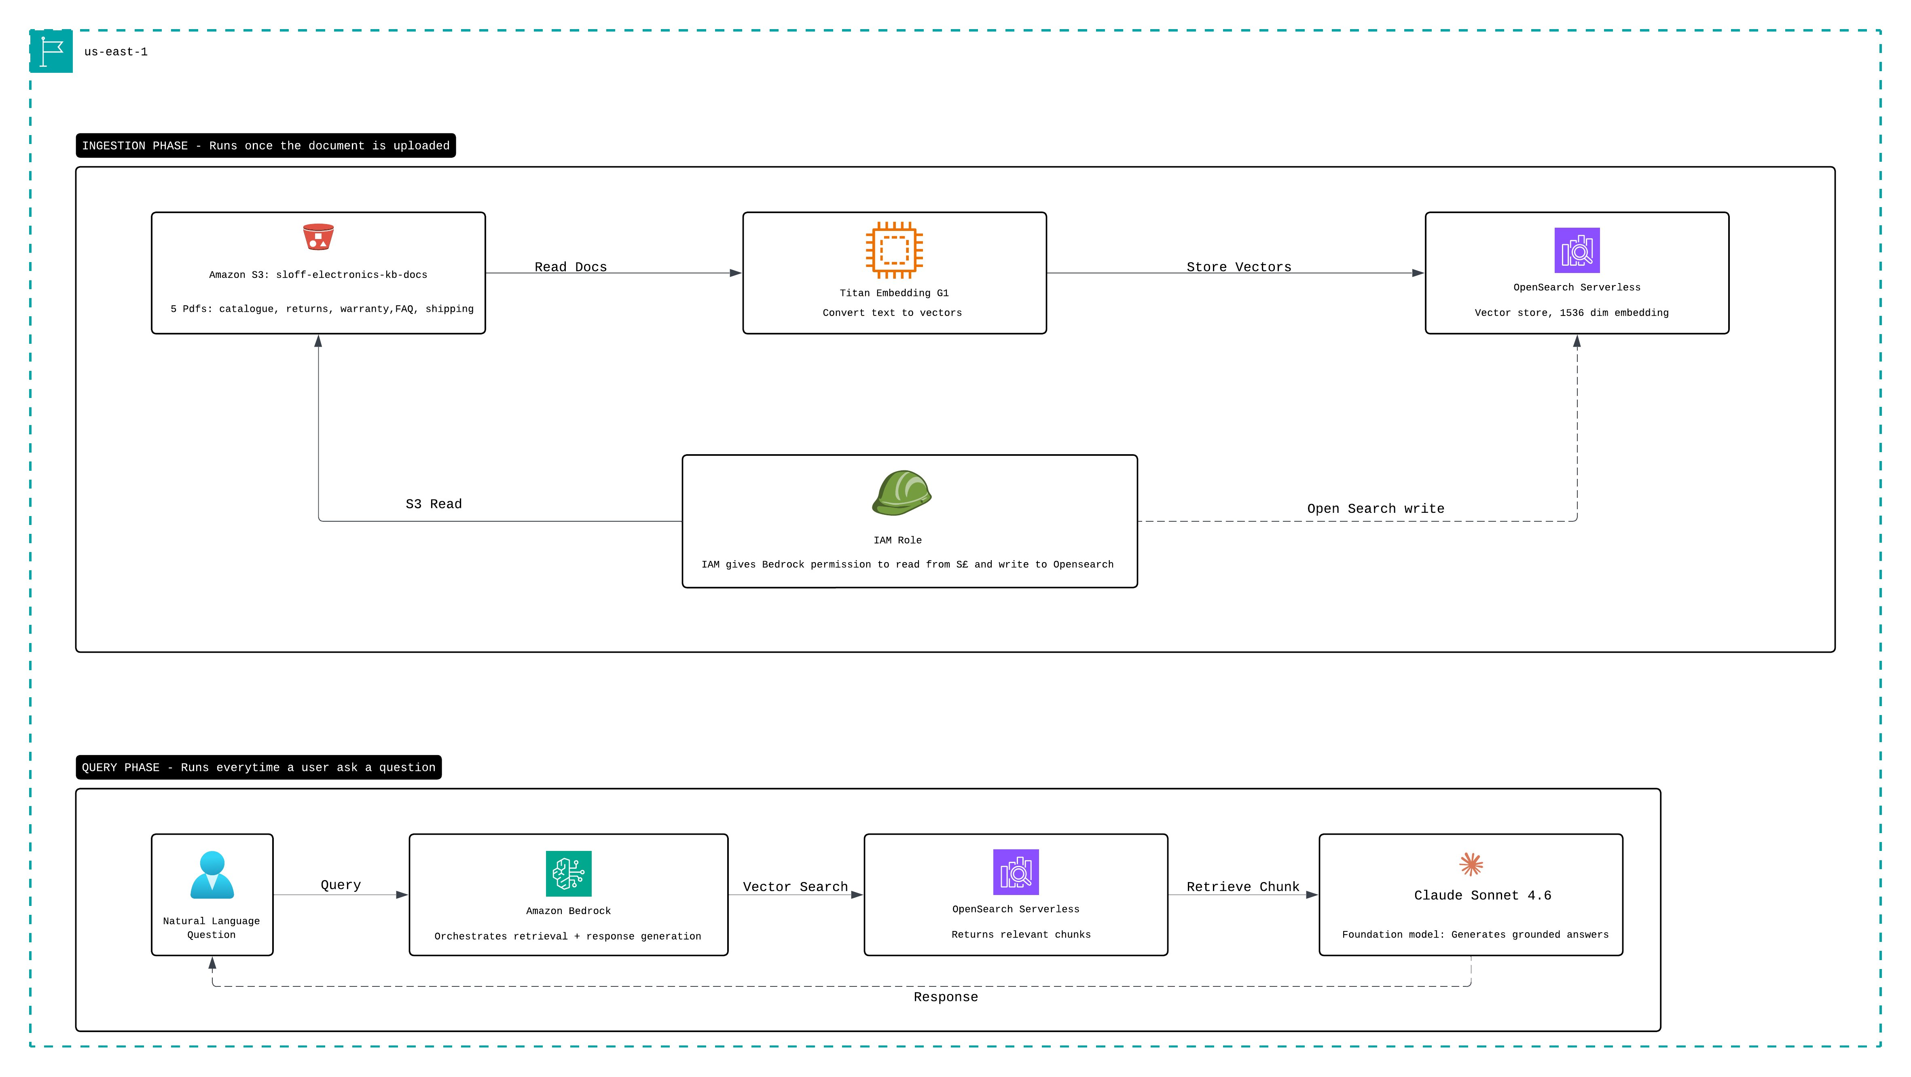
SOLUTION ARCHITECTURE
Two-phase RAG pipeline on AWS Bedrock
Figure 1: Ingestion phase (top) and Query phase (bottom). All services in us-east-1

Slide 4



AWS SERVICES
Six managed services — zero self-managed infrastructure
Amazon S3
Bedrock Knowledge Base
Titan Embeddings G1
Document storage
RAG orchestration
Text → vectors
sloff-electronics-kb-docs · 5 PDFs
sloff-electronics-kb · us-east-1
1536-dimensional embeddings
OpenSearch Serverless
Claude Sonnet 4.6
IAM Service Role
Vector store
Response generation
S3 + OpenSearch access
Auto-provisioned by Bedrock
Anthropic via Bedrock InvokeModel
Auto-generated · scoped permissions

Slide 5

KNOWLEDGE BASE
Five documents powering the chatbot
Product Catalogue
Returns Policy
Warranty Policy
Customer FAQ
Shipping Policy
Laptops, smartphones & accessories
Specifications and UK pricing
Return windows by category
Step-by-step return process
Coverage and exclusions
SloffCare+ extended warranty
Troubleshooting guides
Order tracking & account support
UK, EU & international options
Costs and cut-off times
PDF
PDF
PDF
PDF
PDF
All documents uploaded to Amazon S3 (sloff-electronics-kb-docs · us-east-1) and synced to Bedrock Knowledge Base

Slide 6
LIVE TESTING
5 / 5
All test queries answered correctly
PASSED
How long do I have to return a laptop?
30 days from delivery
Source: Returns Policy
What is the price of the SloffBook Pro 15?
£1,199 inc. VAT
Source: Product Catalogue
Is liquid damage covered under warranty?
No — physical damage excluded
Source: Warranty Policy
My SloffPhone X12 Pro is overheating. What should I do?
3-step guide returned with citation
Source: Customer FAQ
How much does next day delivery cost?
£12.99, cut-off 1:00 PM
Source: Shipping Policy

Slide 7

KEY LEARNINGS
What we learned building this
Root User Restriction
Region Selection Matters
Bedrock Knowledge Base blocks root user operations. Create an IAM user before starting any Bedrock project.
eu-west-2 (London) lacks full Bedrock support. Switch to us-east-1 before building not after.
Anthropic Model Access
Sync Is a Separate Step
Claude models require a use case submission at the Bedrock Model Catalog. Submit on day one, not build day.
Knowledge Base creation does not auto-ingest documents. The sync job must be explicitly triggered after creation.

Slide 8
WHAT WE BUILT
A production-pattern RAG pipeline on AWS
S3 knowledge base — 5 Sloff Electronics documents
5/5
Bedrock Knowledge Base with OpenSearch Serverless vector store
Tests passed
Titan Embeddings G1 — 1536-dimensional vector representations
5
Claude Sonnet 4.6 — grounded response generation
Documents
5 / 5 test queries answered accurately with source citations
6
Extends Sloff Electronics three-tier infrastructure from Group B Assignment 2
AWS services
CloudBoosta Academy · Group B · May 2026 · us-east-1

